Slide 1
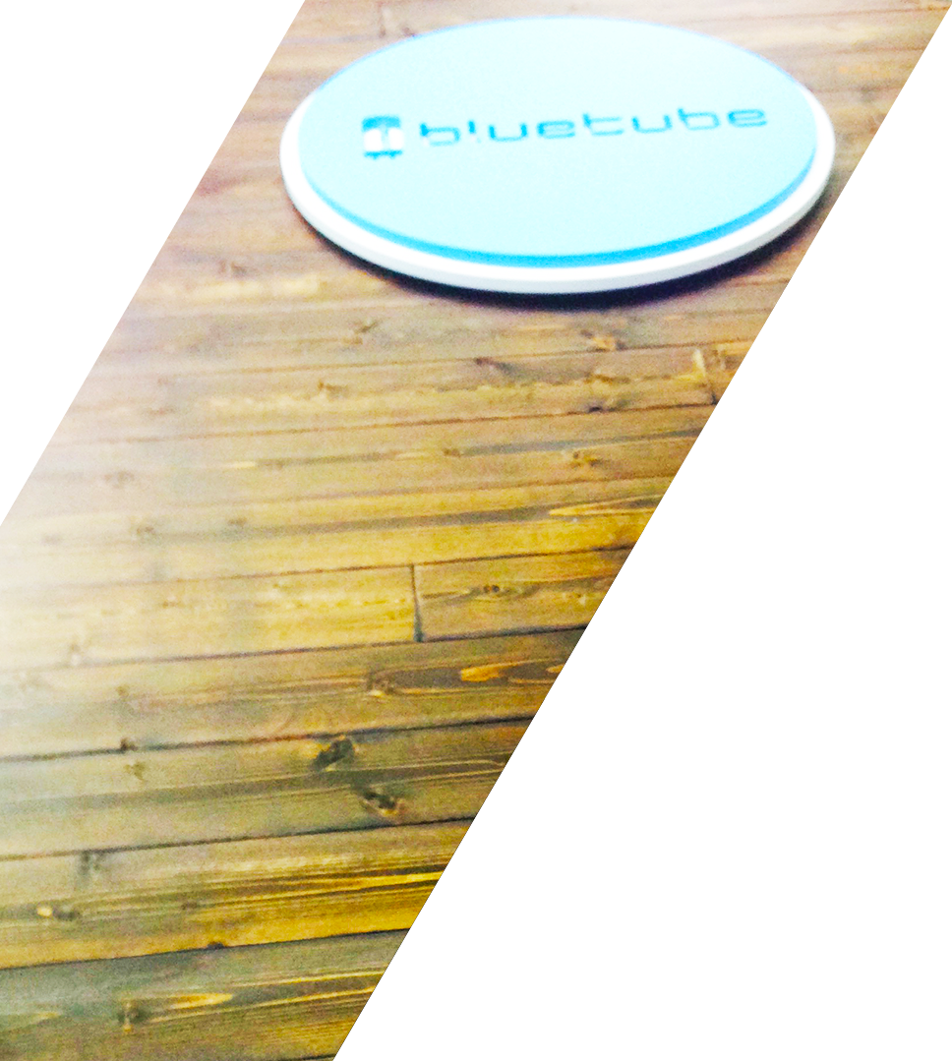
Introduction to Xamarin Test Cloud
Grant Davies
Bluetube CEO
contact@bluetubeinc.com
www.bluetubeinc.com
Notes:
Use your own photo here, don’t keep Craig.
PPT: image needs to be easily replaceable and correctly masked.

Slide 2


WHO IS BLUETUBE
“Bluetube designs and builds for
enterprise native mobile and
responsive web.”
Established in 1999
Award-Winning Solutions Experts with Technology and Usability
Enterprise Corporations & Non-profit Clients
Premier Xamarin Consulting Partner
Xamarin Test Cloud Consulting Partners
Notes:
Add your own title, subtitle, and content; then replace the image and you have a cool slide!
PPT: image needs to be easily replaceable and correctly masked.

Slide 3

Automatically test your app on hundreds of real devices in the cloud
Notes:
[When we open the call have the Xamarin cover slide showing. Adjust subtitle of cover slide to customer requirements and use case.] Just as a quick check, can everyone seen my screen? Automatically test your app on hundreds of real devices in the cloud? Yes? Fantastic. Great talking to you today. How are you? Customer, where are you located? I saw from your linkedin that you’re based in Boston, is that right? Xamarin is based in San Francisco and we really like the weather here. <insert appropriate conversation to build a connection> Customer, who else will be joining the call from your side? Are we waiting for anyone else to join from your side? Why don’t we start with a quick round of introductions? Customer, do you want to start on your side, give everybody a moment to introduce themselves, and maybe give a brief background and cover their particular goals for this call with Xamarin. [Customer is making introductions.]

Slide 4


Mobile Quality Challenges
Device Fragmentation
App Complexity
Fast Release Cycles
Short Sessions
High Mobile User Expectations
Notes:
These are the 5 top challenges when it comes to mobile quality. Device fragmentation and app complexity make it hard to build apps that work well on a wide variety of devices. The lifecycle for mobile is much faster than traditional desktop development. Users use mobile apps differently, in short sessions, putting pressure on performance, and they have high expectations for great experiences and are vocal when they are not met.

Slide 5

US Device Market Coverage Data
288
Companies must test on 134 devices to get to 75% U.S. market coverage
Number of Devices
134
45
13
0
Market Share
25%
50%
75%
90%
Notes:
This data illustrates exactly how challenging the device fragmentation problem is—with testing on 134 devices required to get 75% market coverage in the U.S. Many companies today still test on only a handful of devices, or invest millions in testing labs that have to keep up with a constantly changing device landscape.

Slide 6

Notes:
To make that chart more real and tangible, this slide here represents just a subset of the Samsung Android screen-sizes and resolutions that a developer for Android needs to support today. There are actually more, we couldn’t fit them all on the slide.
Between different device operating systems, form factors, screen sizes, resolutions, chip sets, and manufacturer modifications, it is difficult to know that your app works well on all devices

Slide 7
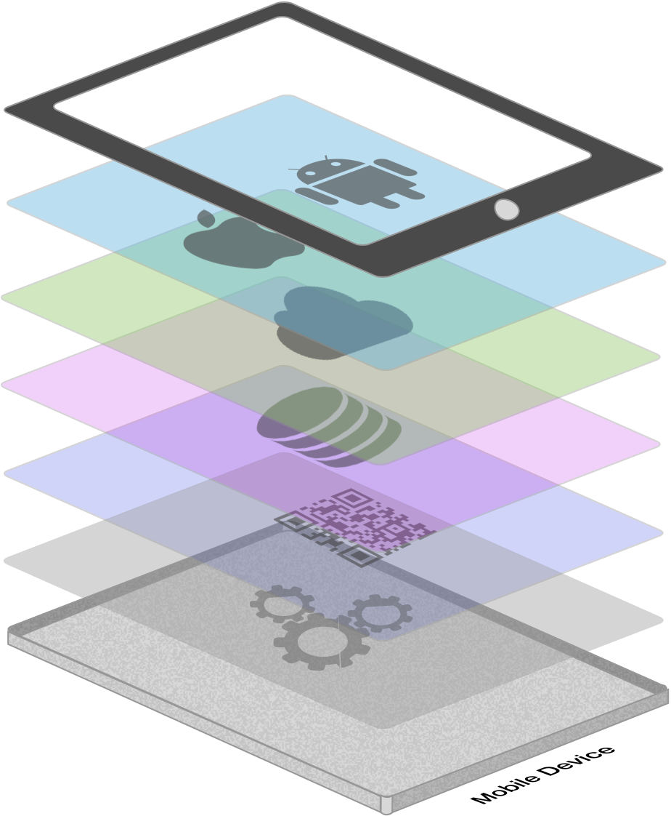






App Complexity
Thousands of iOS and Android APIs
Public web APIs
Backend integrations
Third party libraries
Memory, CPU and network constraints
Notes:
So, there’s a fragmented device landscape, yet users expect apps to work perfectly on the device of their choice. They also expect great mobile features. There is quite a bit of complexity in delivering a great app.
There are thousands iOS and Android APIs. Apple and Google just recently had their user conferences here in San Francisco, and each announced over 5,000 APIs in their upcoming device operating system releases alone. In addition, manufacturers such as Samsung and Amazon each add their own device-specific APIs, adding further complexity.
The average app consumes about 5 public web APIs – such as social login and sharing, news feeds, photo sharing, and cloud storage are just a few examples.
Most apps have some sort of connections to business systems. Internal apps deliver company data, and consumer apps often surface account and product information.
There are several 3rd party libraries consumed in most mobile apps – from bar code scanning, to charting, to encryption libraries, to authentication, to messaging protocols and more.
All of these great mobile features need to be delivered on these tiny computers in our pockets with limited memory and CPU resources, and subject to network latency, spikes and disconnects.
Pulling off a great app on a single device is difficult – pulling it off on hundreds of devices is exponentially more difficult.

Slide 8
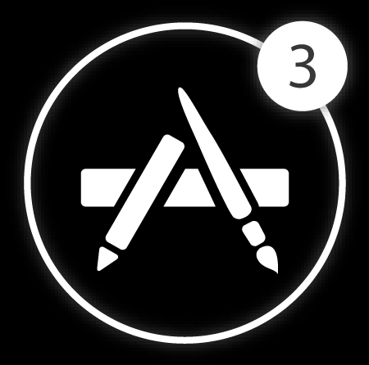


Fast Release Cycles
Short Sessions
High Mobile User Expectations
Notes:
Because the mobile landscape is rapidly changing, the mobile lifecycle is much faster than traditional desktop app development. Users expect new features and continuous improvements in mobile apps. As a result, several companies are moving to very fast release cycles for mobile, sometimes as short as 2 weeks.

Slide 9
High Test Realism
Automated UI testing is the only way to ensure your app
looks
behaves and
performs
well on a broad set of devices—
with every release
Beta Testing
Automated UI Testing
Manual Testing
Rapid Iterations
Long Cycles
Unit Testing
Simplistic Tests
Notes:
If you look at the mobile testing options available today, most of them have significant flaws. Manual testing and beta testing are highly realistic, but they don’t scale at all. It is difficult to do this kind of labor-intensive testing across hundreds of devices, and do it for every release. Unit testing is very fast, but does not provide complete test coverage of the entire mobile end user experience.
What you really need is Automated UI Testing that basically replicates the motions of a human manual tester, in order to have rapid iterations but also to have a high test-realism. You also need to be able to do this on hundreds of real devices, in real time, to ensure fast time-to-market

Slide 10

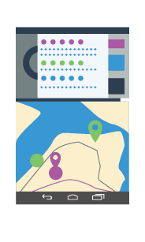
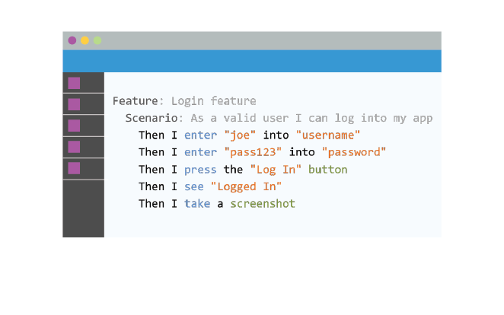
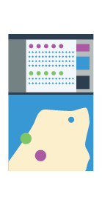
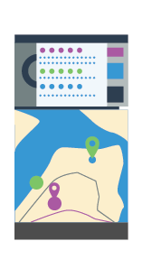
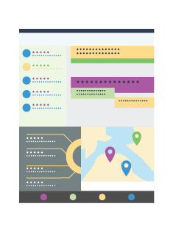
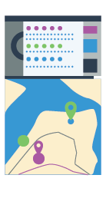
The End-to-End Mobile Quality Solution
Local UI Test Authoring
Cloud Testing Lab
Notes:
Now let’s talk about how Xamarin Test Cloud helps solve these challenges.
At the most elemental level, Xamarin Test Cloud consists of two things. A test scripting environment where you easily automate the testing of every step a user takes through your app, running locally first. Xamarin Test Cloud is also a device lab accessible through the cloud where you execute your script on hundreds of devices at once, and get beautiful results analytics that help you identify and troubleshoot, bugs, crashes, UI problems, and memory and performance issues.

Slide 11
Test Any Native or Hybrid App
Notes:
You can test any native or hybrid mobile app with Xamarin Test Cloud, not just Xamarin apps. Objective-C apps, Java apps, Appcelerator, Phonegap. If the app can be downloaded from a public or private app store, it can be tested in Xamarin Test Cloud.

Slide 12








Examples of User Interactions
Tap
Scroll
Swipe
Pinch
Multi finger
Text Entry
Rotation
GPS
Notes:
Here are some examples of the types of user interactions you can automate with Xamarin Test Cloud, including complex gestures, screen rotation, and text entry. In addition, we provide full access to devices so you can also test hardware interactions like setting the GPS.

Slide 13
DEMO

Slide 14
Xamarin store demo

Slide 15


Jenkins
TFS
TeamCity
Incorporate Xamarin Test Cloud into your continuous integration environment to shorten the feedback cycle and prevent users from finding regressions
Notes:
Xamarin Test Cloud is particularly powerful when integrated into Continuous Integration processes so that you can ensure that every release is a quality release. Nothing frustrates users more than a new release that breaks their favorite feature. Find these regressions fast with Xamarin Test Cloud as part of your CI process. Xamarin Test Cloud supports Jenkins, TFS and Team City.

Slide 16








The End-to-End Mobile Quality Solution
Test on Real Devices
Be confident that your apps function correctly and look great on real devices that are not rooted or jail broken.
Analyze Results Quickly
More than detailed technical feedback, stunning visual reporting performance monitoring
Beat Fragmentation
Test automatically on hundreds of combinations of operation systems, screens and resolutions
Accelerate with Continuous Integration
Integrate Xamarin Test Cloud into your continuous integration process or ALM to make every release a quality release
Start immediately
Dedicated QA engineers get you up and running with Xamarin Test Cloud fast and ensure your ongoing success
Author Tests Easily
Test your entire app, from the UI down, using object-level user interface testing
Notes:
To summarize, Xamarin Test Cloud is the fastest and easiest way to know that your apps work on your users’ choice of devices. This is a complete solution, from our Quick Start team that helps you get started, to test execution on hundreds of real devices, to beautiful, actionable analytics that you can access via the Test Could web portal, or integrate into your CI environments.

Slide 17
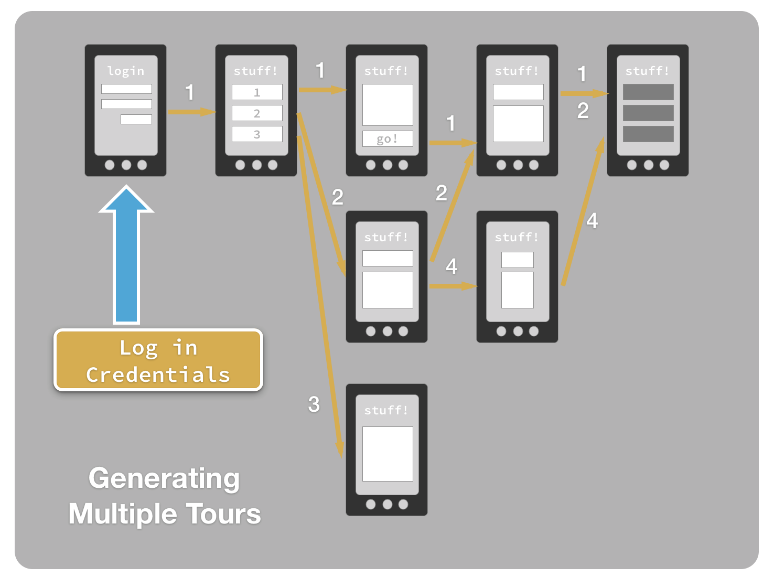
App Explorer
Walk your app Walks every screen/button in your app to look for crashes and major issues.
“Generation” Tours the app and performing actions like “tapping buttons”

Slide 18
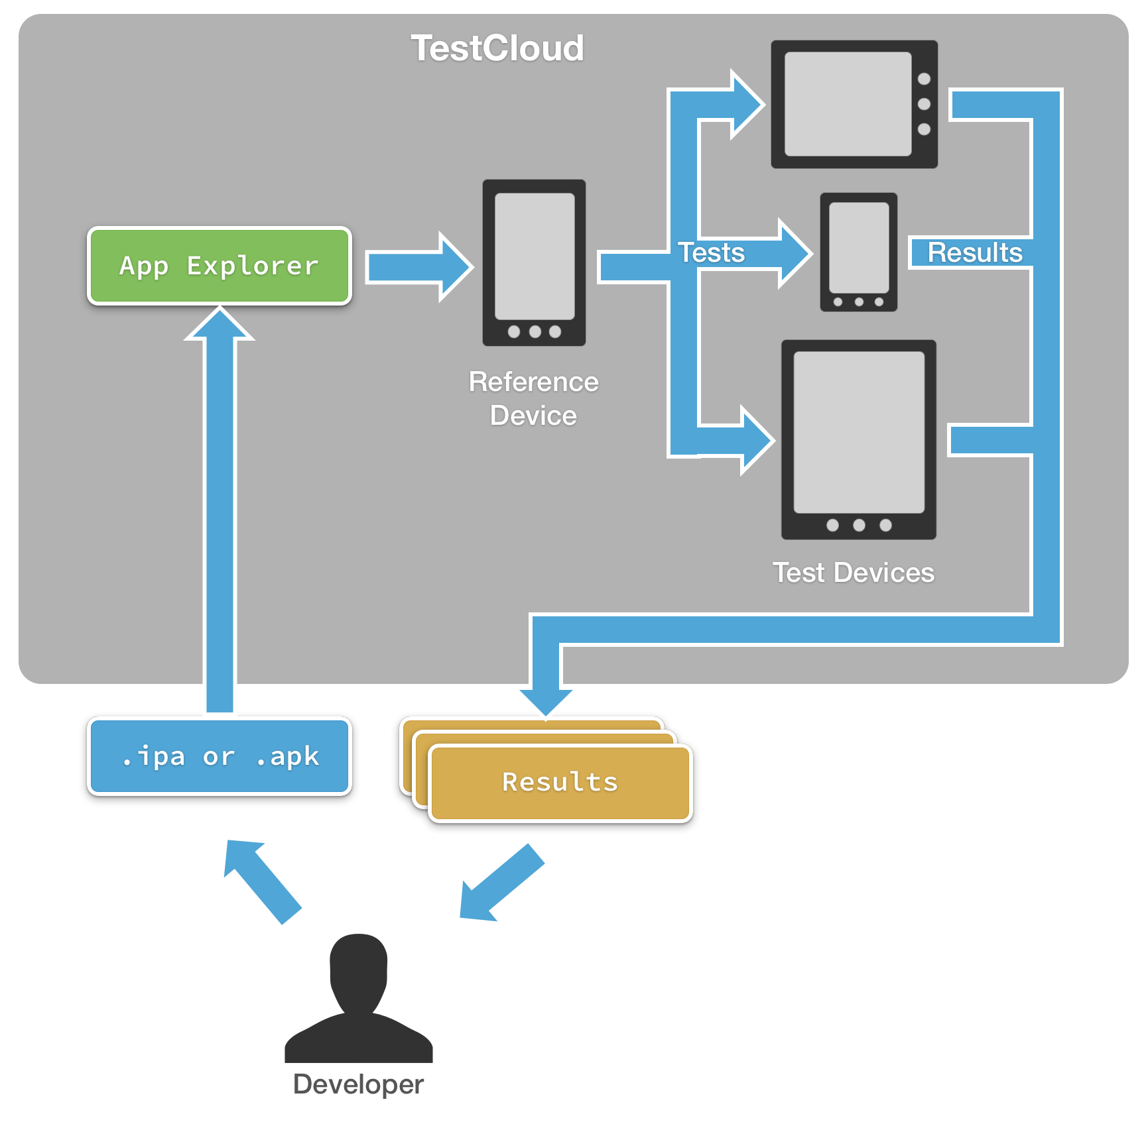
App Explorer
Run Phase Runs the app through your suite of test devices
App Crashes
Missing UI
Can’t install

Slide 19
Xamarin Test Cloud Monthly Pricing – Consulting Partners
 | Basic | Plus | Professional | Business | Enterprise
Monthly Fee | $1,000 | $2,000 | $5,000 | $8,000 | $12,000
Apps | 1 | 1 | 1 | 1 | 1
Monthly Device Hours | 200 | 400 | 1000 | 1600 | 2400
Email Support | Yes | Yes | Yes | Yes | Yes
Service Level Agreement | - | Normal | Normal | Normal | Enterprise
Dedicated Customer Success Manager | - | - | Yes | Yes | Yes

Slide 20

Xamarin Test Cloud
Partner Program

Slide 21
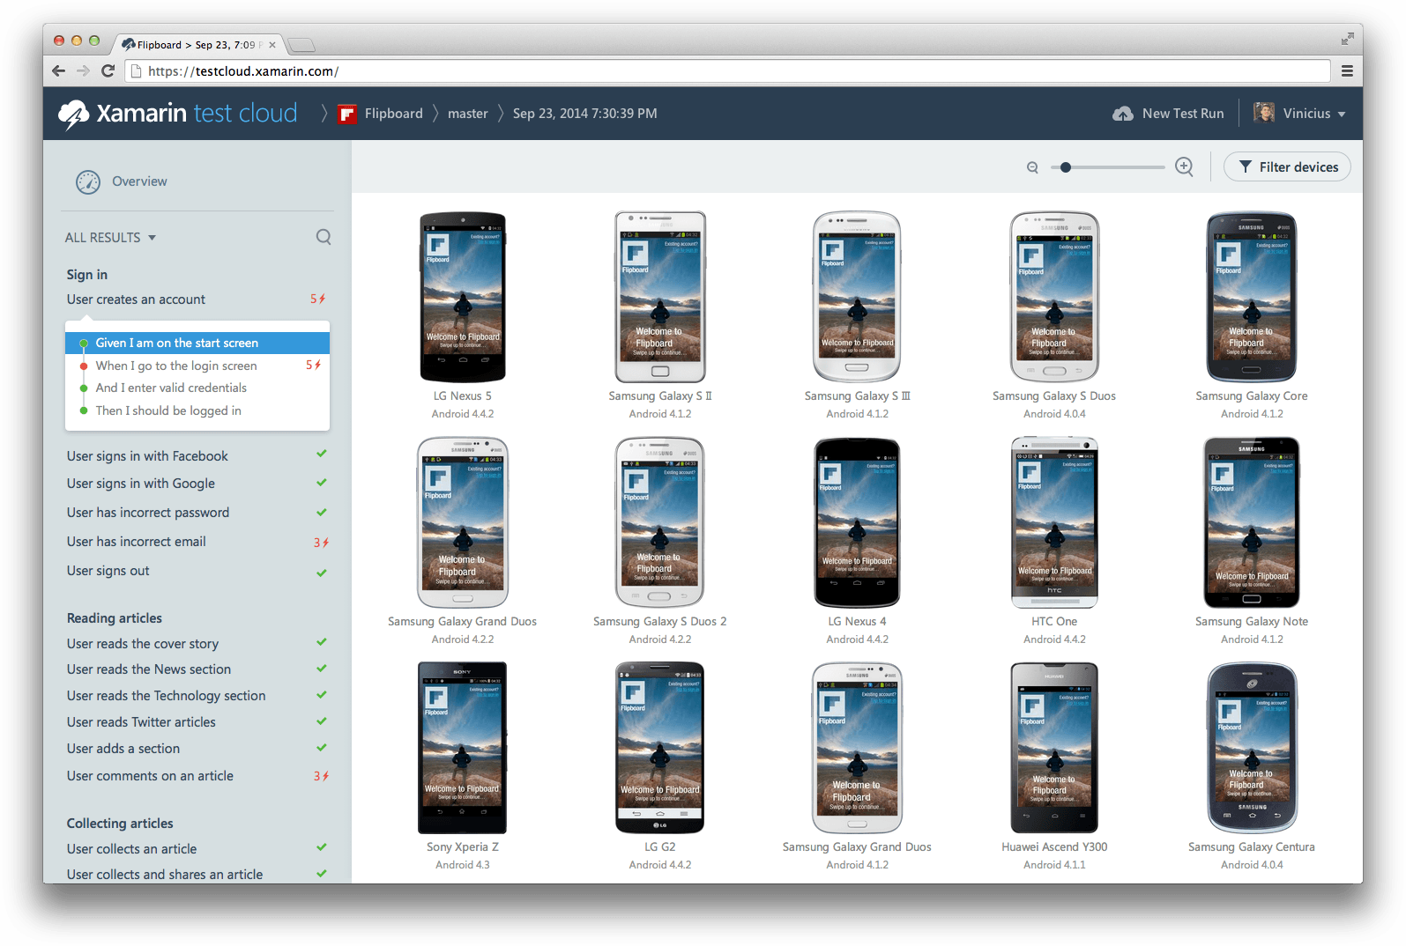
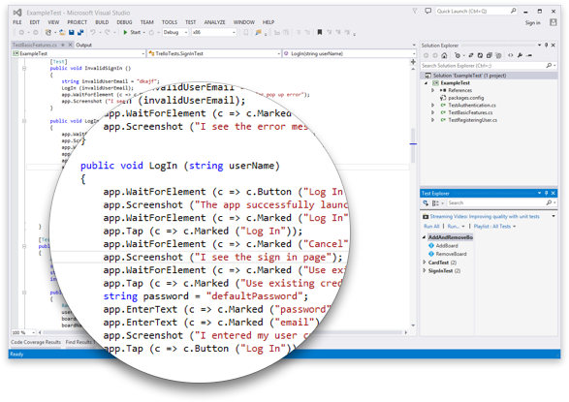
How can partners use Xamarin Test Cloud?
Demo
Test Services

Slide 22

Test Cloud Partner Program Benefits
Listed on Xamarin Partner Page
Referrals for Xamarin Test Cloud Testing Services
Xamarin Test Cloud Sales & Marketing Resources
Special Partner Pricing
XTC Demo Subscription ($1,000/YR| 250 Device Hours for Demos)
Month-to-Month Subscriptions

Slide 23
Test Cloud Partner Program Requirements
Xamarin Test Cloud Partner Certification
Attend Xamarin University XTC Classes
Pass XTC Certification Exam
Attend Xamarin Test Cloud Partner Training Webinar

Slide 24




Thank You
Tuesday, Jan 13, 2015 at 12pm EST
www.virtualusersgroup.org/xamarin
@VirtualXamarin
www.bluetubeinc.com/blog
Notes:
Our next Virtual Xamarin Presentation will be Tuesday, January 13 at 12pm EST. RSVP NOW to attend.
The top link is for anyone who would like to register for future Virtual Xamarin Users Group Presentations.
Follow this the Virtual Xamarin Users Group on Twitter @VirtualXamarin to stay in contact with your peers and to receive instant updates about this users group
Also, thank you to Bluetube for helping support this users group. They provide insightful technical articles every Tuesday. They cover a range of topics from mobile, responsive web, and UX/UI design. I provided their blog link below in case you were interested!

Slide 25
Xamarin Test Cloud Annual Pricing
 | Basic | Plus | Professional | Business | Enterprise | Unlimited
Monthly Fee | $1,000 | $2,000 | $5,000 | $8,000 | $12,000 | $16,000
Apps | 2 | 4 | 4 | 10 | 20 | Unlimited
Monthly Device Hours | 200 | 400 | 1000 | 1600 | 2400 | Unlimited
Priority Test Execution |  |  | Yes | Yes | Yes | Yes
Custom Test Authoring “Quick Start” |  |  | 1 week | 2 weeks | 3 weeks | 4 weeks
Expert Ongoing Automation Consulting |  |  |  | 4 hours / month | 8 hours / month | 16 hours / mo
Live Online Automation Training from Xamarin University |  | 1 | 1 seat | 3 seats | 5 seats | 25 seats
Email Support | Yes | Yes | Yes | Yes | Yes | Yes
Dedicated Customer Success Manager |  | Yes | Yes | Yes | Yes | Yes
Service Level Agreement |  |  | Normal | Normal | Enterprise | Enterprise

Slide 26
Beautiful Test Results

